Slide 1
3-Level Space Vector PWM
PREPARED BY
Joey De Guzman
Firmware engineer
Lite-On Singapore
21-Nov, 2022

Slide 2
Overview
3-Level SVPWM introduction
3-Level SVPWM design
3-Level SVPWM implementation
3-Level SVPWM test results
Reference

Slide 3
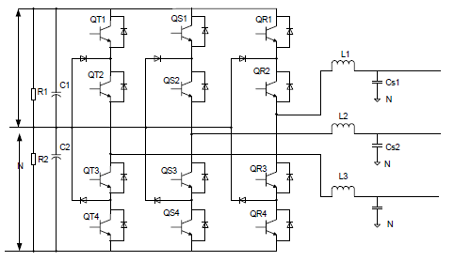
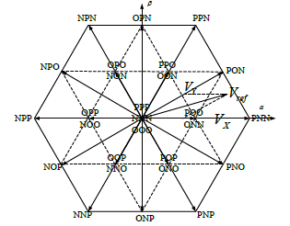
3-Level SVPWM Introduction
Space vector PWM
is a control technique to generate sine wave based on a reference input space vector (or vector sum) of a three-phase system
due to its scheme of limiting the switching of the actuators by one at a time, the number of short pulse are limited resulting to reduced total harmonic distortion
3-Level SVPWM
Vector Diagram
NPC Three-phase

Slide 4
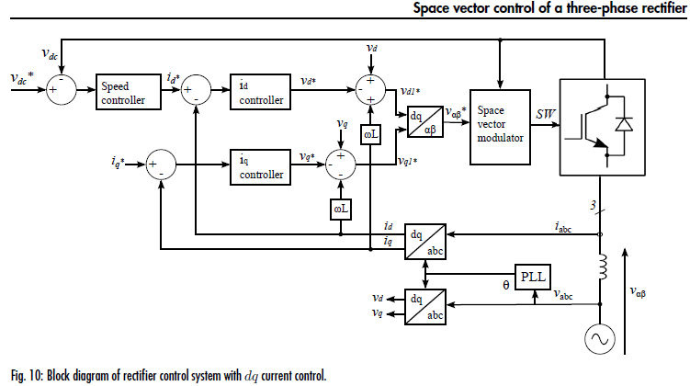
3-Level SVPWM Introduction
DQ control with 3-Level SVPWM [2]

Slide 5
3-Level SVPWM Design
3-Level SVPWM blackblox
3-Level SVPWM
v_{alpha}, v_{beta}
Control PWM for phase A
Control PWM for phase B
Control PWM for phase C
(3)
Midpoint voltage
balancing coefficient [1] [3]

Slide 6
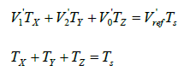
3-Level SVPWM Design
3-Level SVPWM procedure [4]
Identify main sector
Identify mapping vector
Calculate fictuous space vector
Identify subsector
Calculate dwelling times of the vector components
Generate comparator based on dwelling times and switching sequence
Given voltage reference
6

Slide 7
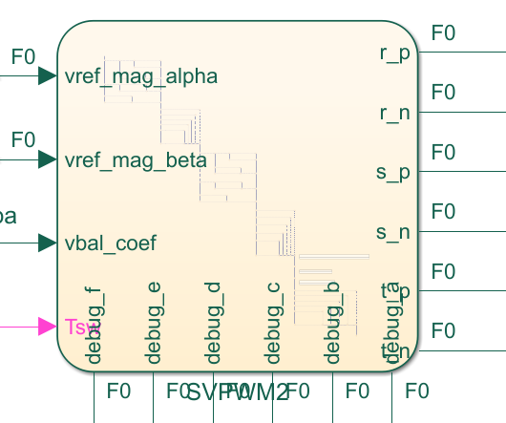
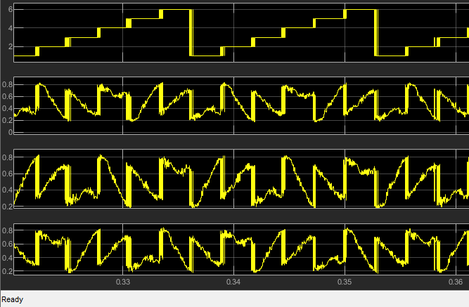

3-Level SVPWM Implementation
Please refer to: http://git001/fw-sgp/11kw_evps_primary/-/commits/master SHA: 3a1ef9fb5a555c06e682dd12053424cead756445
Modulating wave/comparator to generate 12 PWMs
12 PWMs into the 3-phase NPC
Implementation in MATLAB
7

Slide 8
3-Level SVPWM Test procedure
Closed loop performance test and analysis for DQ0, SVPWM for 3p3w rectifier
Input Vac: 311Vrms, 400Vrms, 480Vrms (all 60Hz)
Load: dynamically changing from 5% to 105% load:
time=0s → 5% load
time=0.2s → 55% load
time= 0.3s → 105% load
time= 0.4s → 55% load
time= 0.5s → 5% load
Efficiency is measured at full load
iTHD is measured at full load
PFC is measured at full load

Slide 9
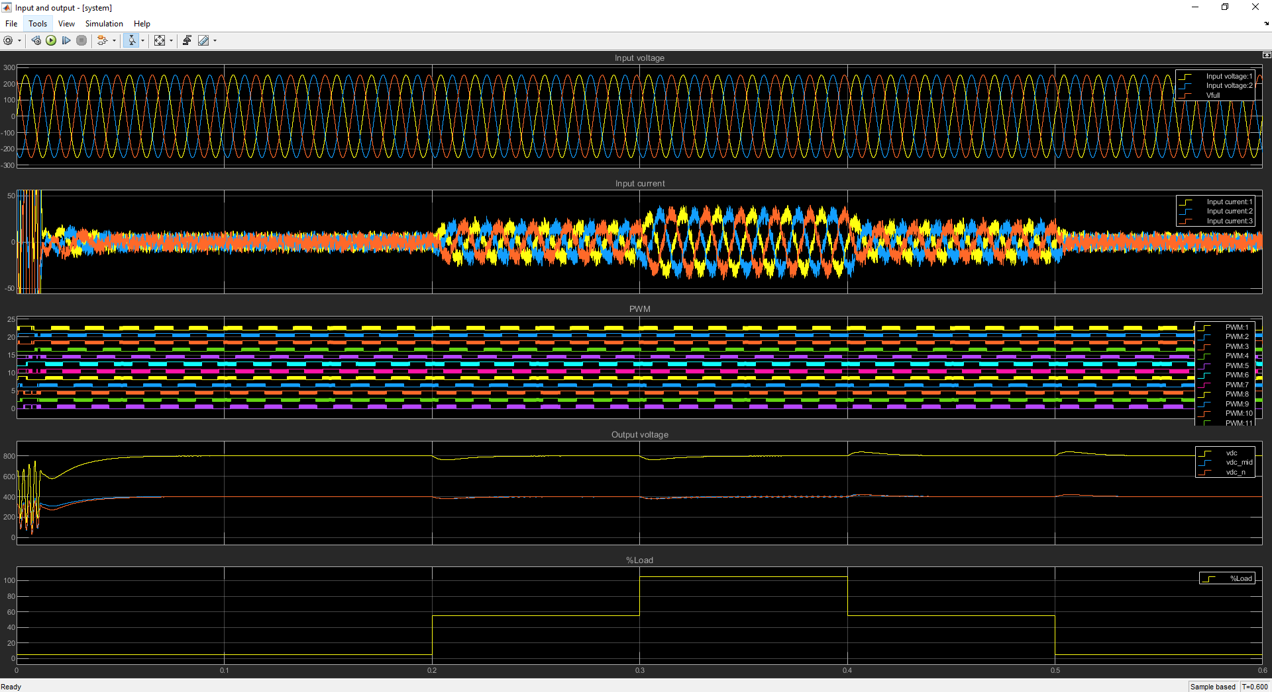
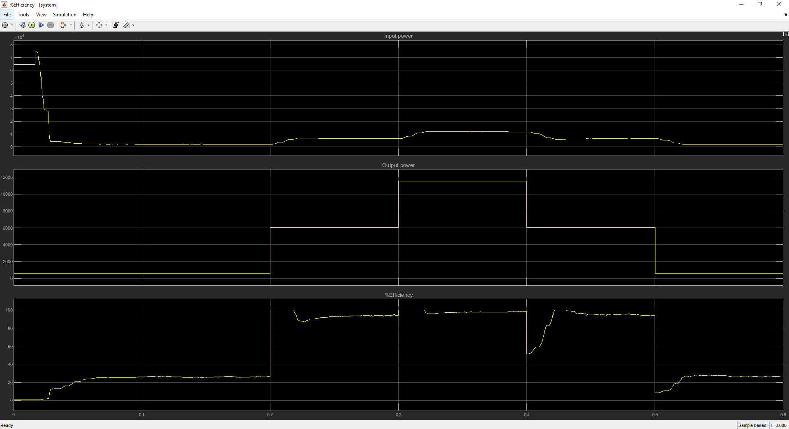
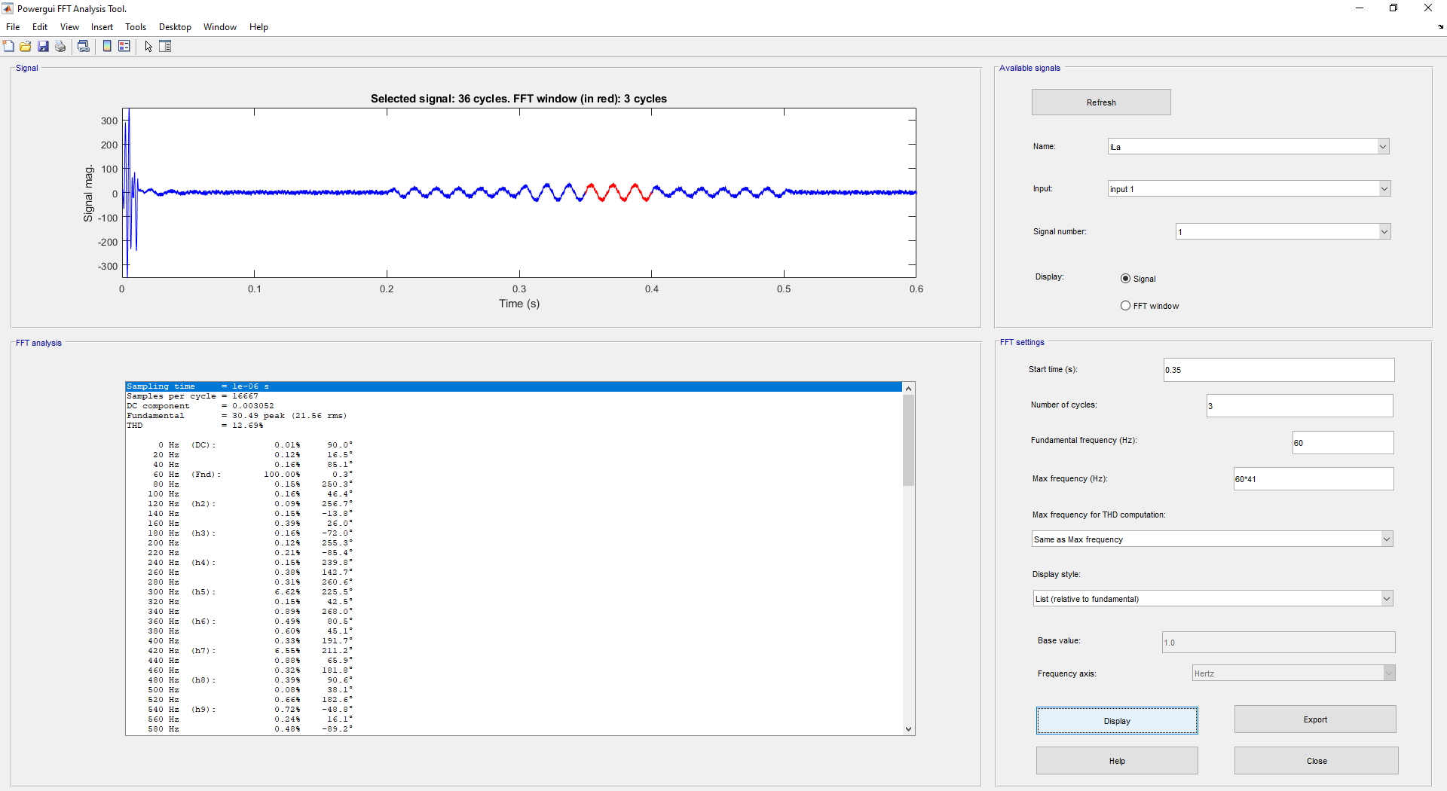
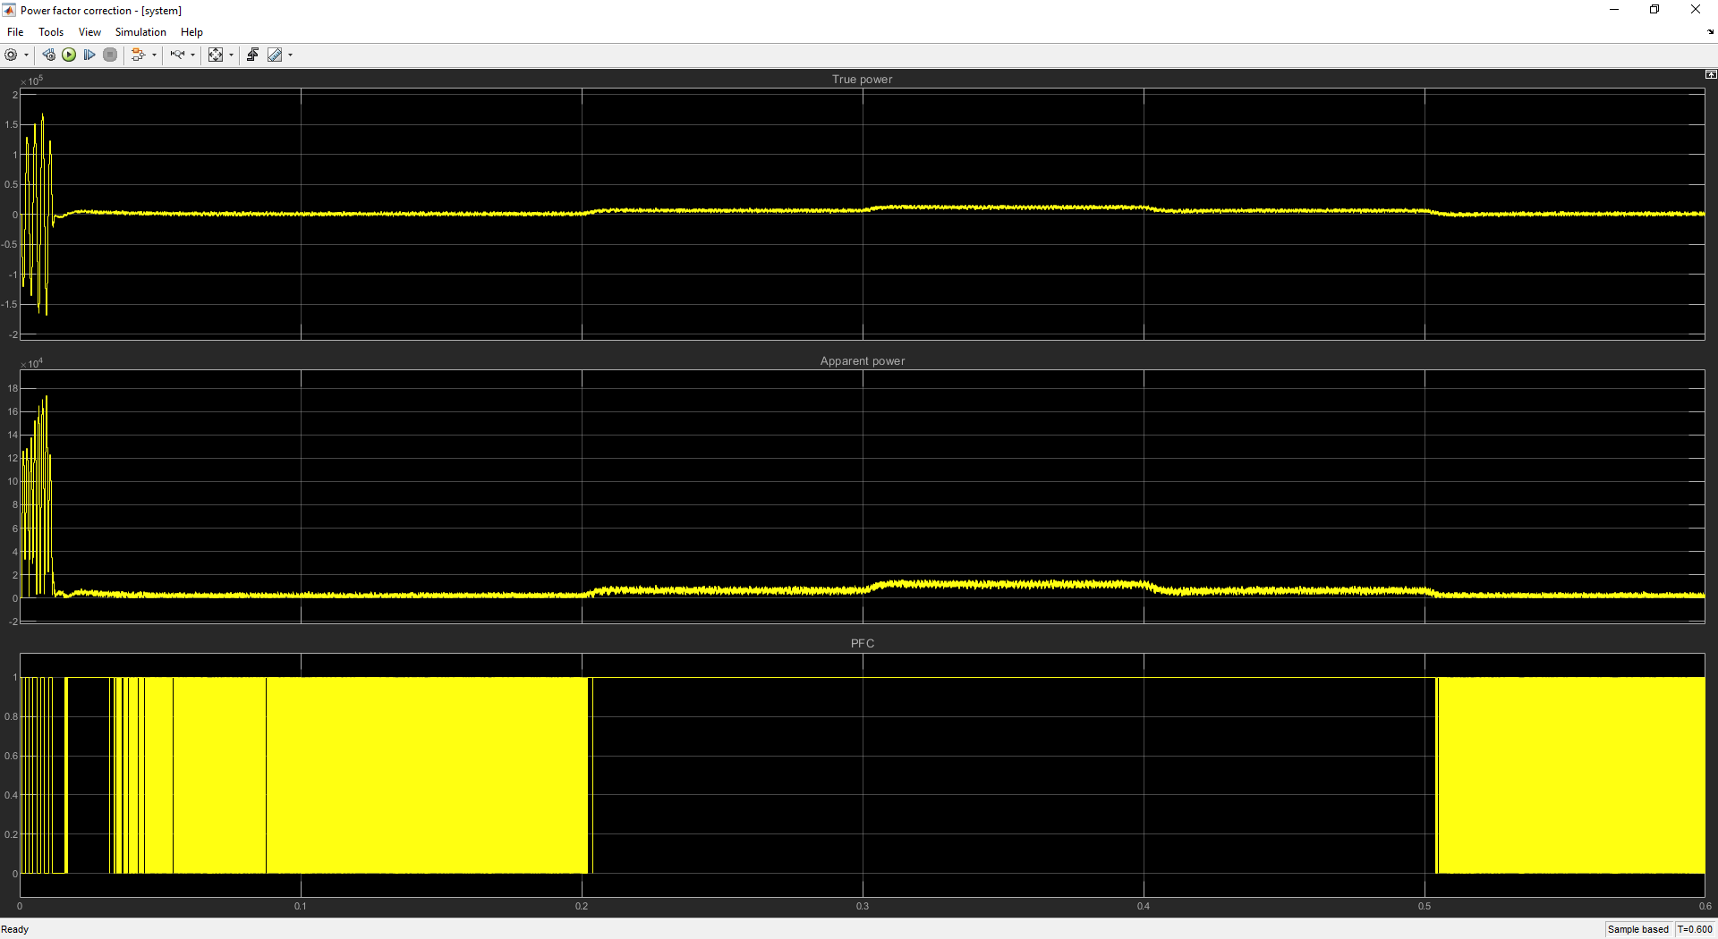
3-Level SVPWM Test results: 311Vrms, 60Hz input
Input and output
Efficiency
iTHD
PFC

Slide 10
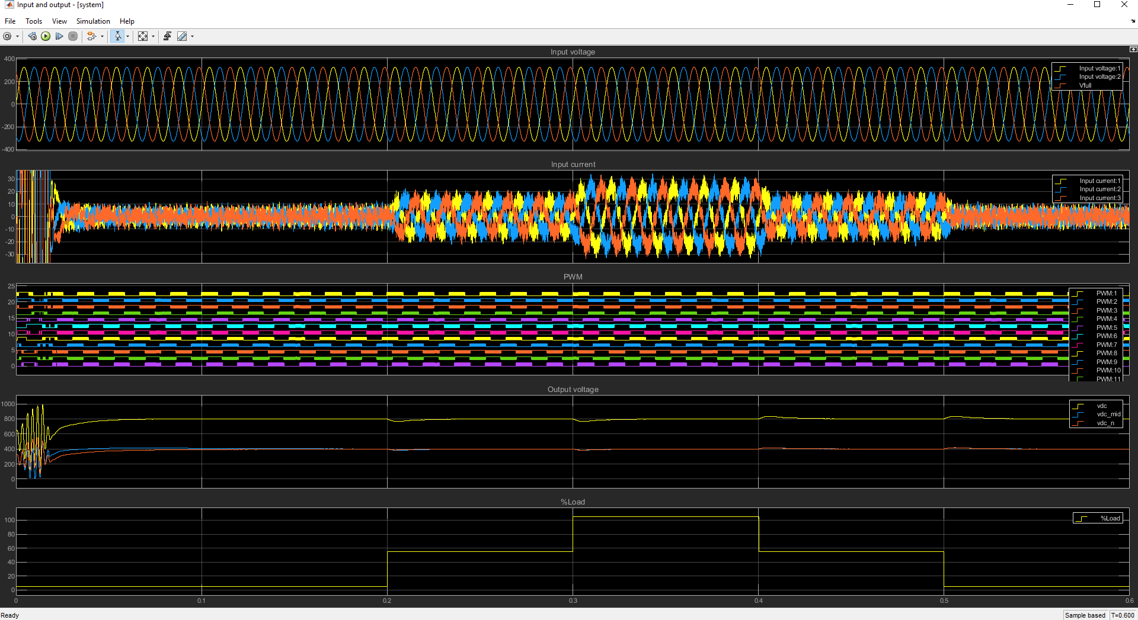
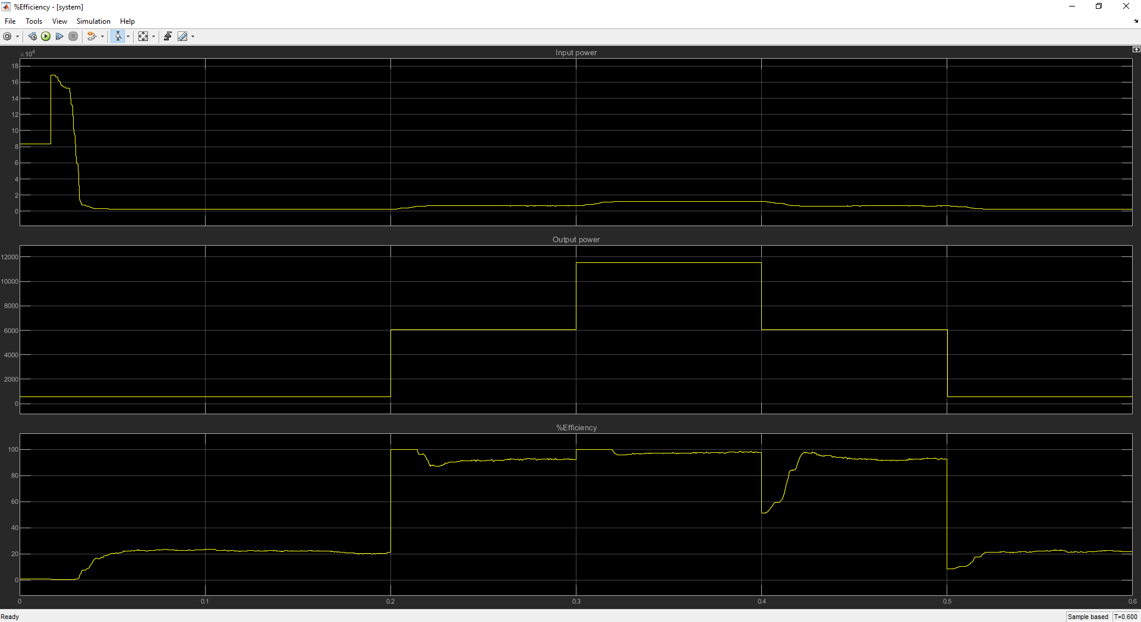
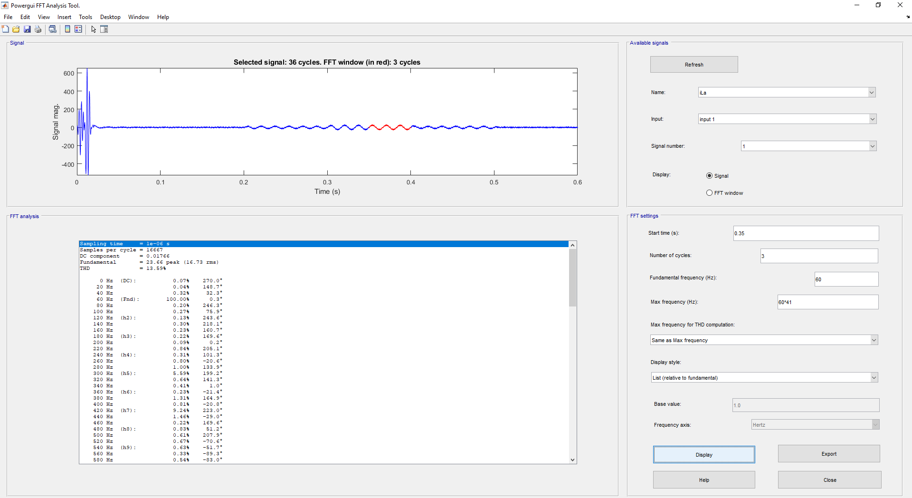

3-Level SVPWM Test results: 400Vrms, 60Hz input
Input and output
Efficiency
iTHD
PFC

Slide 11
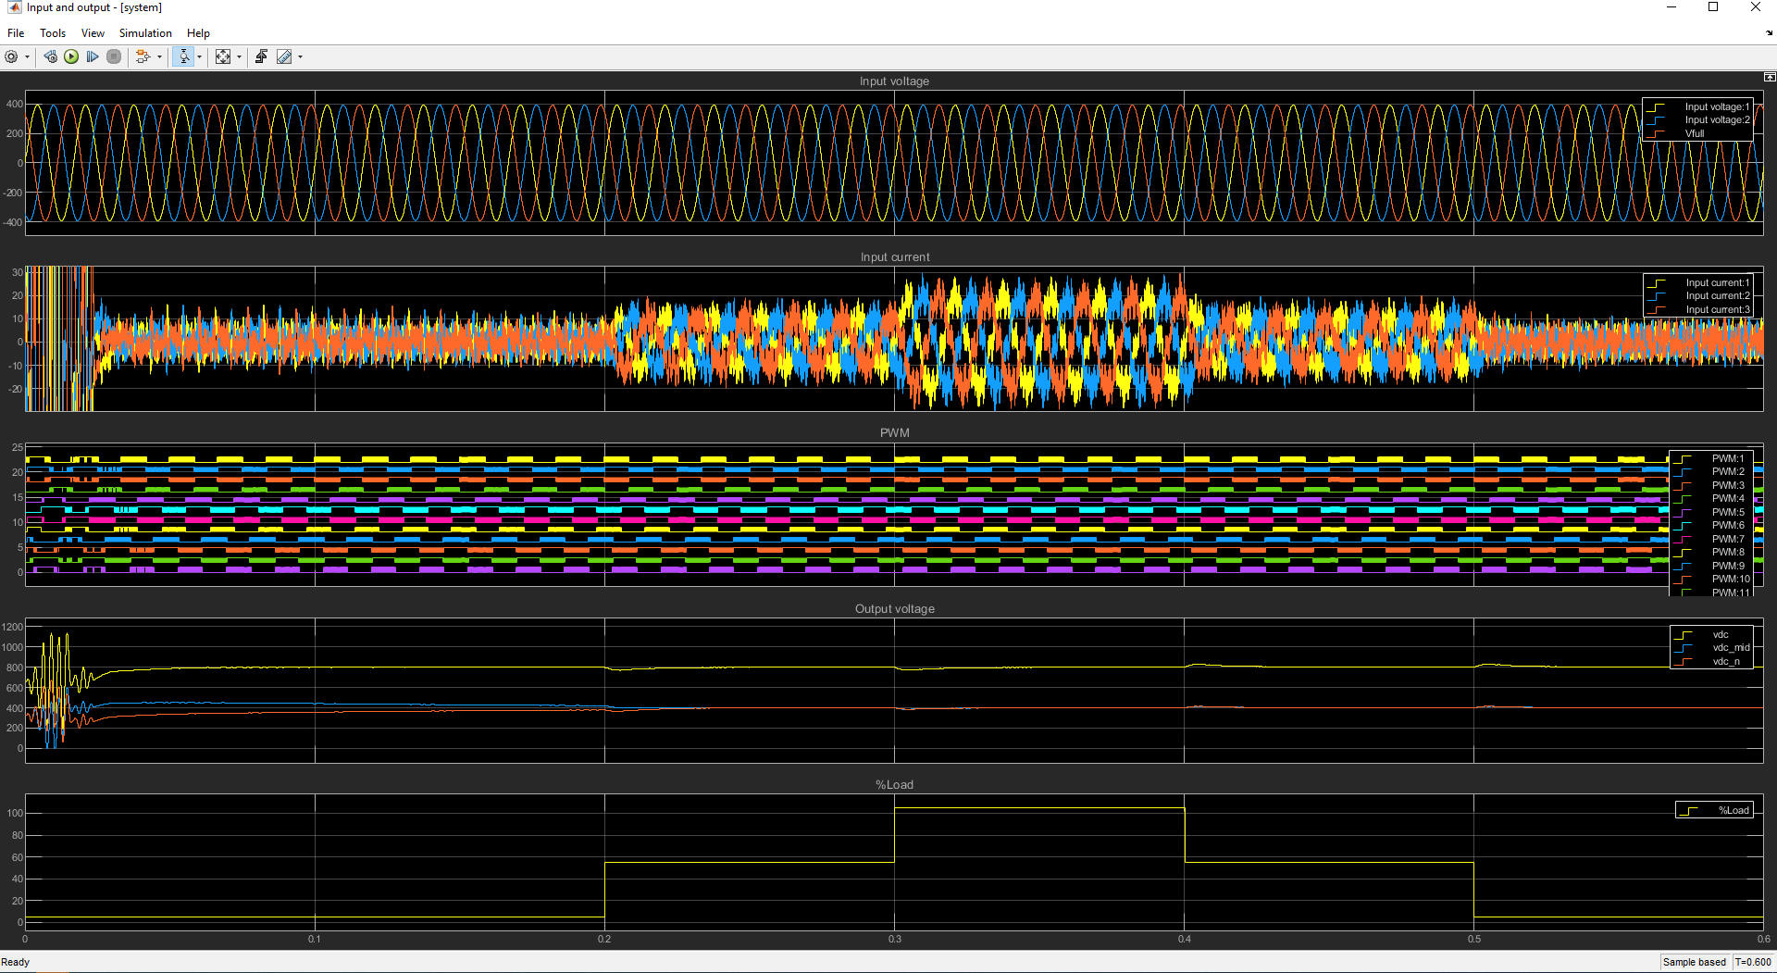

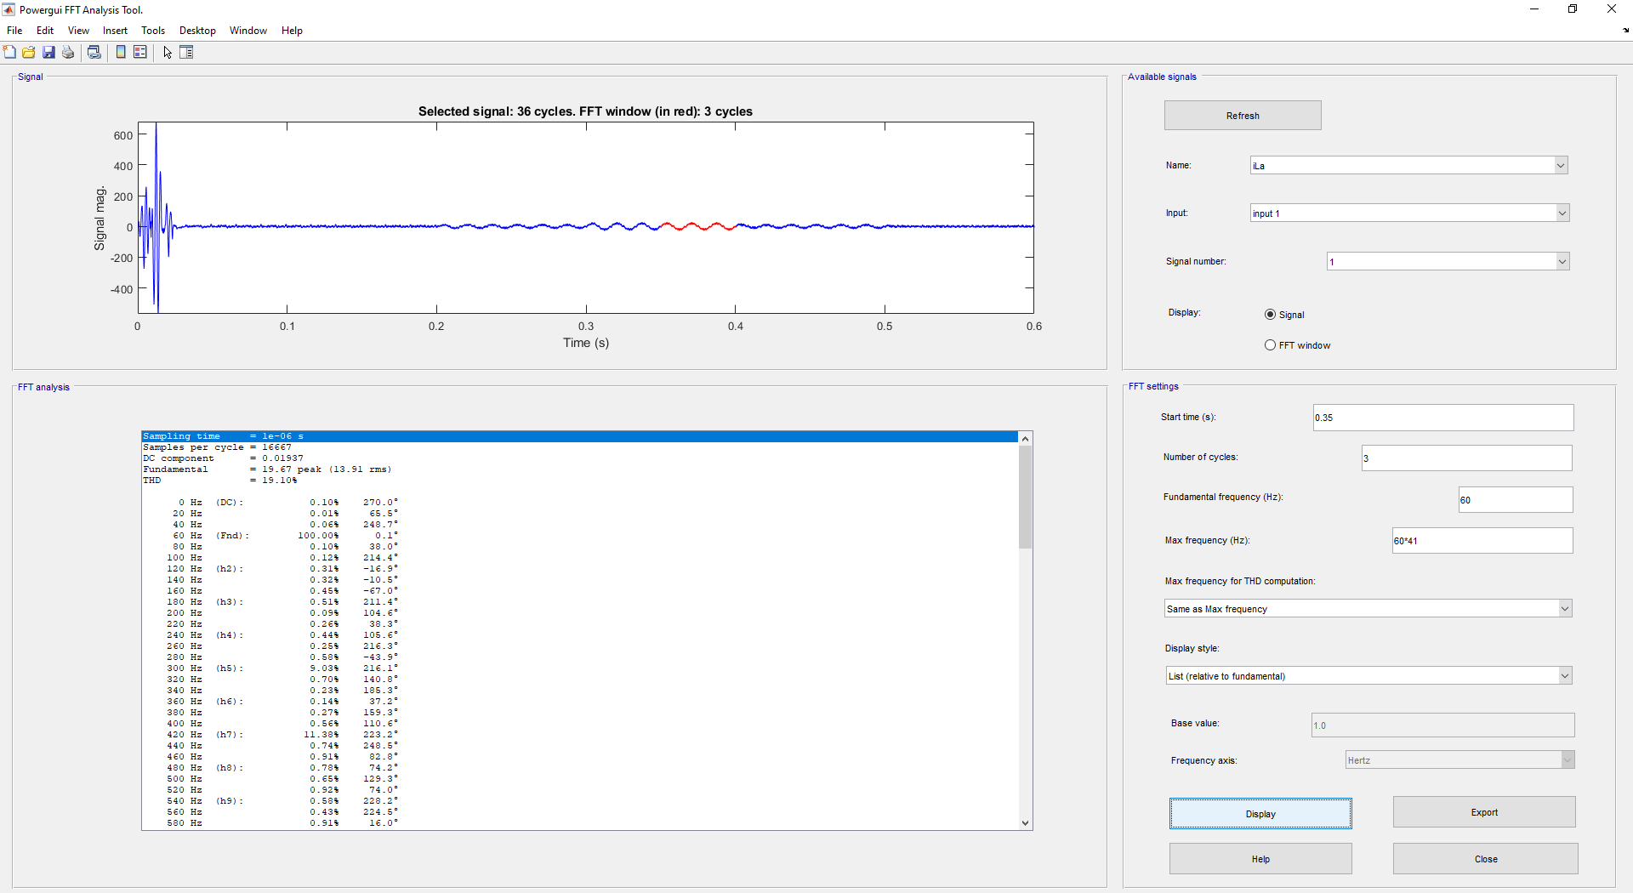

3-Level SVPWM Test results: 480Vrms, 60Hz input
Input and output
Efficiency
iTHD
PFC

Slide 12
3-Level SVPWM Test results
Results with simple 3-Level SVPWM implementation:
Input Vac (Vrms) | Efficiency | iTHD (%) | PFC @105%load | Steady-state vdc ripple (V) | Dynamic load overshoot @55%-55%load (V) | Dynamic load overshoot @55%-55%load (V)
311 | 98.3 | 12.69% | ~1 | 2 | 38.5 | 18
400 | 98 | 13.59% | ~1 | 2.1 | 33.3 | 32.7
480 | 97.1 | 19.10% | ~1 | 2.5 | 29 | 29.3
Can be improved by applying:
Improvement in the main sector selection
New studies and techniques in 3-Level SVPWM

Slide 13
Reference
[1] Beig, A. (2007). Modified SVPWM Algorithm for Three Level VSI With Synchronized and Symmetrical Waveforms (Vol. 54). IEEE Transactions on Industrial Electronics. https://doi.org/10.1109/TIE.2006.888801
[2] Schönberger, J. (n.d.). https://www.plexim.com/sites/default/files/plecs_svm.pdf. https://www.plexim.com/sites/default/files/plecs_svm.pdf
[3] Seo, J. (2001). A new simplified space-vector PWM method for three-level inverters (Vol. 16). IEEE Transactions on Power Electronics. https://doi.org/10.1109/63.931078
[4] Xue, V. (2012). Center-Aligned SVPWM Realization for 3- Phase 3- Level Inverter. https://www.ti.com/lit/pdf/sprabs6

Slide 14
Thank You
Connect with LITEON

